Slide 1




Leveraging User Experience of Prototype Tool using SLE technologies
---An introduction to EMF tooling ---
2018
Didier Vojtisek (Inria)
http://people.rennes.inria.fr/Didier.Vojtisek/
Didier.vojtisek@inria.fr

Slide 2
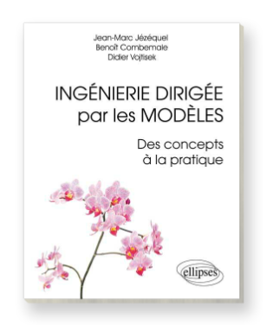
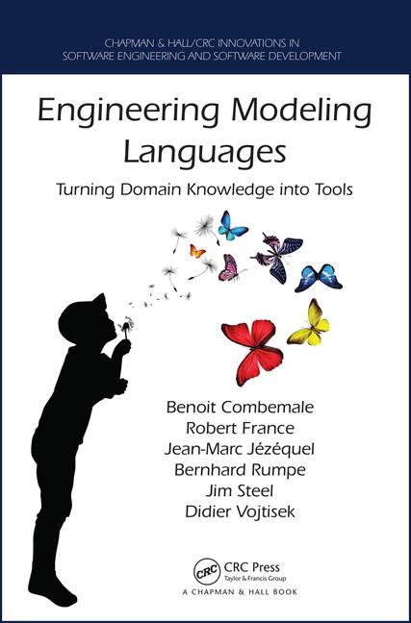
Crash course
This will be fast and we will not cover everything...
Please ask question or do not hesitate to come back later to see me or one of the DiverSE team teachers and researchers

Slide 3
Course main purpose
Most tools benefit from having a good user interface and user assistance. Some technologies helps to have very high level feature with very limited development cost. Thus making this kind of features available also for prototypes.
This course shows a set of technologies based on Eclipse and Modeling to (semi-automatically) build the tooling that can be presented as a dedicated IDE for your concepts.

Slide 4
This course is for you if you have some concepts in your domain and:
□ You're bored to write or maintain parser and printyprinter dedicated to the concepts you want to expose
□ You wish to create text editors with good user support (highlighting, autompletion, …)
□ You wish to create diagramatic view/editors
□ Your concepts have an execution semantics and providing a debugger to your users is a nice to have feature (with connection to the editors)

Slide 5
Course content
Day ay1– modelingodeling
Tn:Hands-onGettingextual editors : Xtext
Hand on: Logo language textual editoreditor
Common extensions (generator, validator, transfo )
Generalization to languages
Some background notions
Ecore/MOF
Concrete syntaxessyntaxessynta
Behavioral semanticsmantuicsSe
Day 2 – modelingodeling (cont.)
Hands-on: Graphical editors
Sirius
Hands-on: Executable behavior
visitor/xtend, dispatch/K3
model debugger
GEMOCGemoc
More usages
Cf. p6/7 Mde book
Day 3. Eclipse specific
Architecture and Plugins
UI, builders, etc
Deployment
Continuous integration
Scaling up - Going further
LSP / Eclipse Che/Theia

Slide 7
You will learn how to
Automatically translate abstract design models to executable code, test cases and documentation
Automatically manipulate your model/code to analyze and refactor it
Build or customize your own abstractions, or even software languages and development environments, to build complex, domain-specific, software-intensive systems
Eventually limit the accidental complexity of industrial processes developments

Slide 8
Additionally, you will also
Demystify language formalisms, paradigms and principles
Have a deeper insight on some of them
Manage the industrial complexity of developments and associated toolchains

Slide 9
Why ?
Providing a tool (or a prototype) to user implies to offer options and /or configurations
often require one (or several) input configuration file(s)
These files may
grow in complexity
require validation (including structural cross references)
require parsing
error feeback
require an AST in order ro manipulate its content
What about having an enhanced editor that helps the user avoiding mistakes
Each action seems to be relatively simple individually but tedious to integrate altogeter.

Slide 10
What is a language?
« A system of signs, symbols, gestures, or rules used in communicating »
« The special vocabulary and usages of a scientific, professional, or other group »
« A system of symbols and rules used for communication with or between computers. »

Slide 11
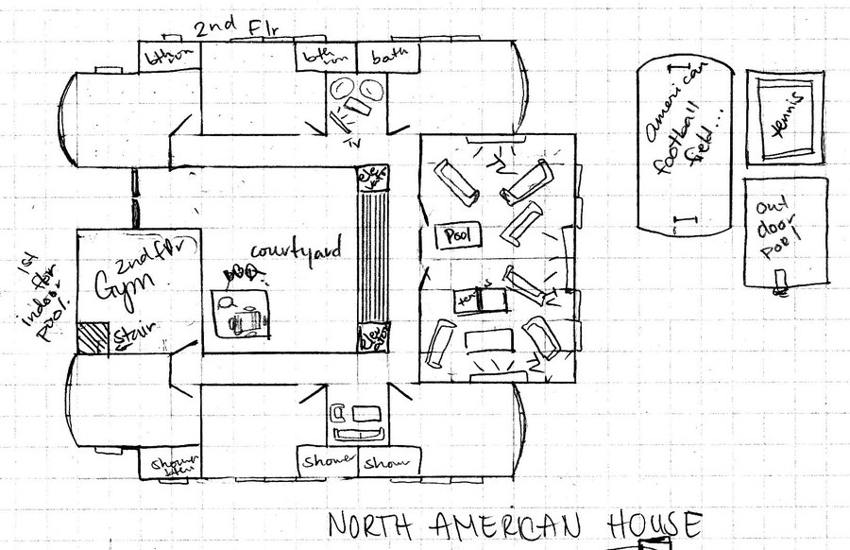
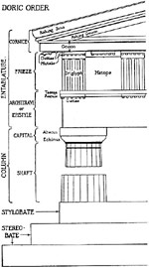
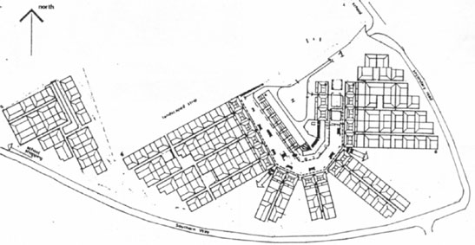
Architecture
Architecture

Slide 12
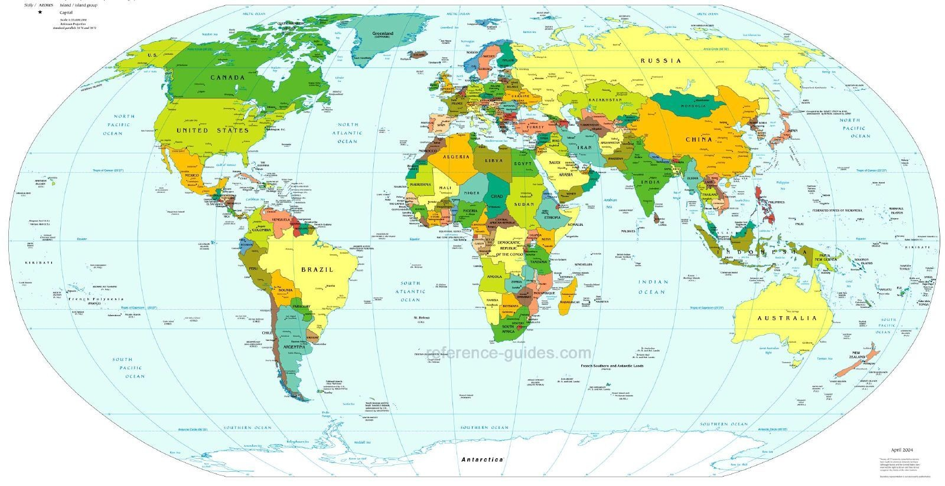
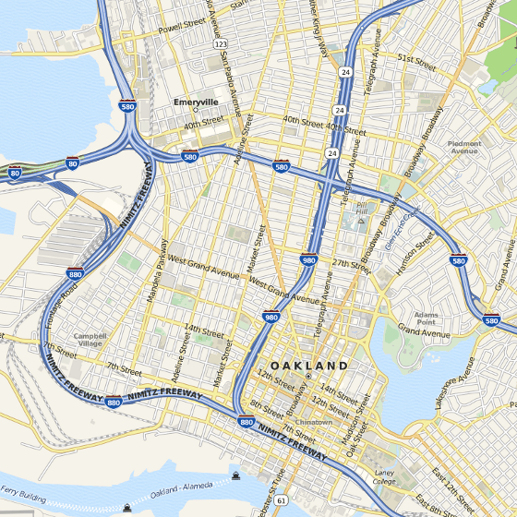
Cartography
Cartography

Slide 13
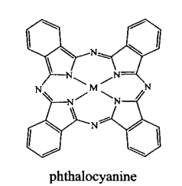
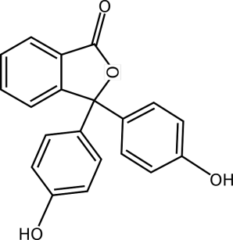
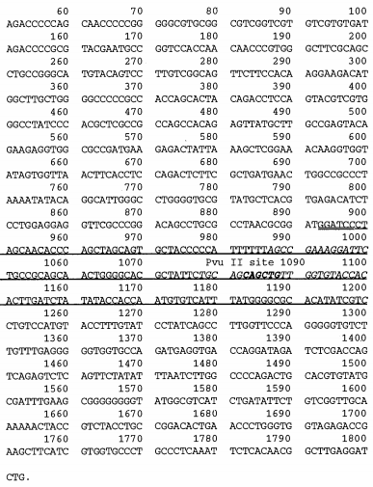
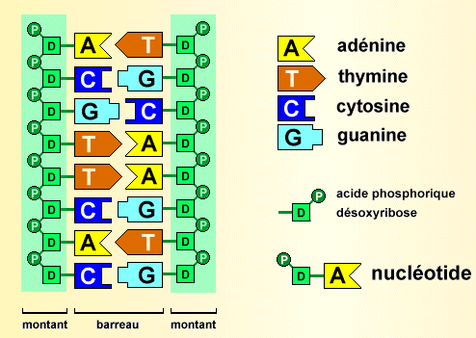
Biology
Biology

Slide 14
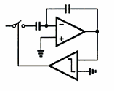
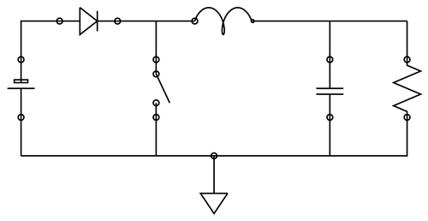
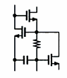
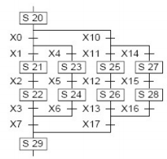
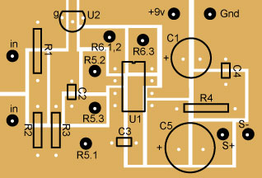
Electronics
Electronics

Slide 15
In Software Engineering
« Languages are the primary way in which system developers communicate, design and implement software systems »

Slide 16
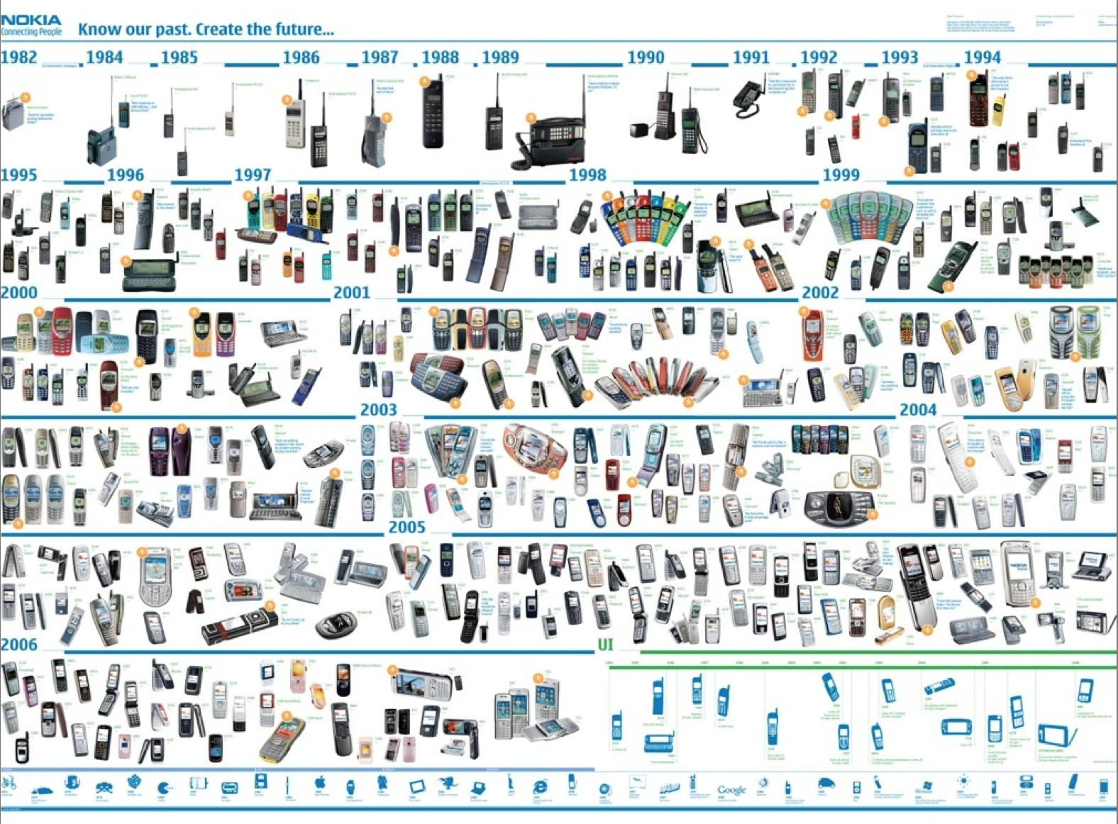





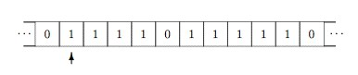
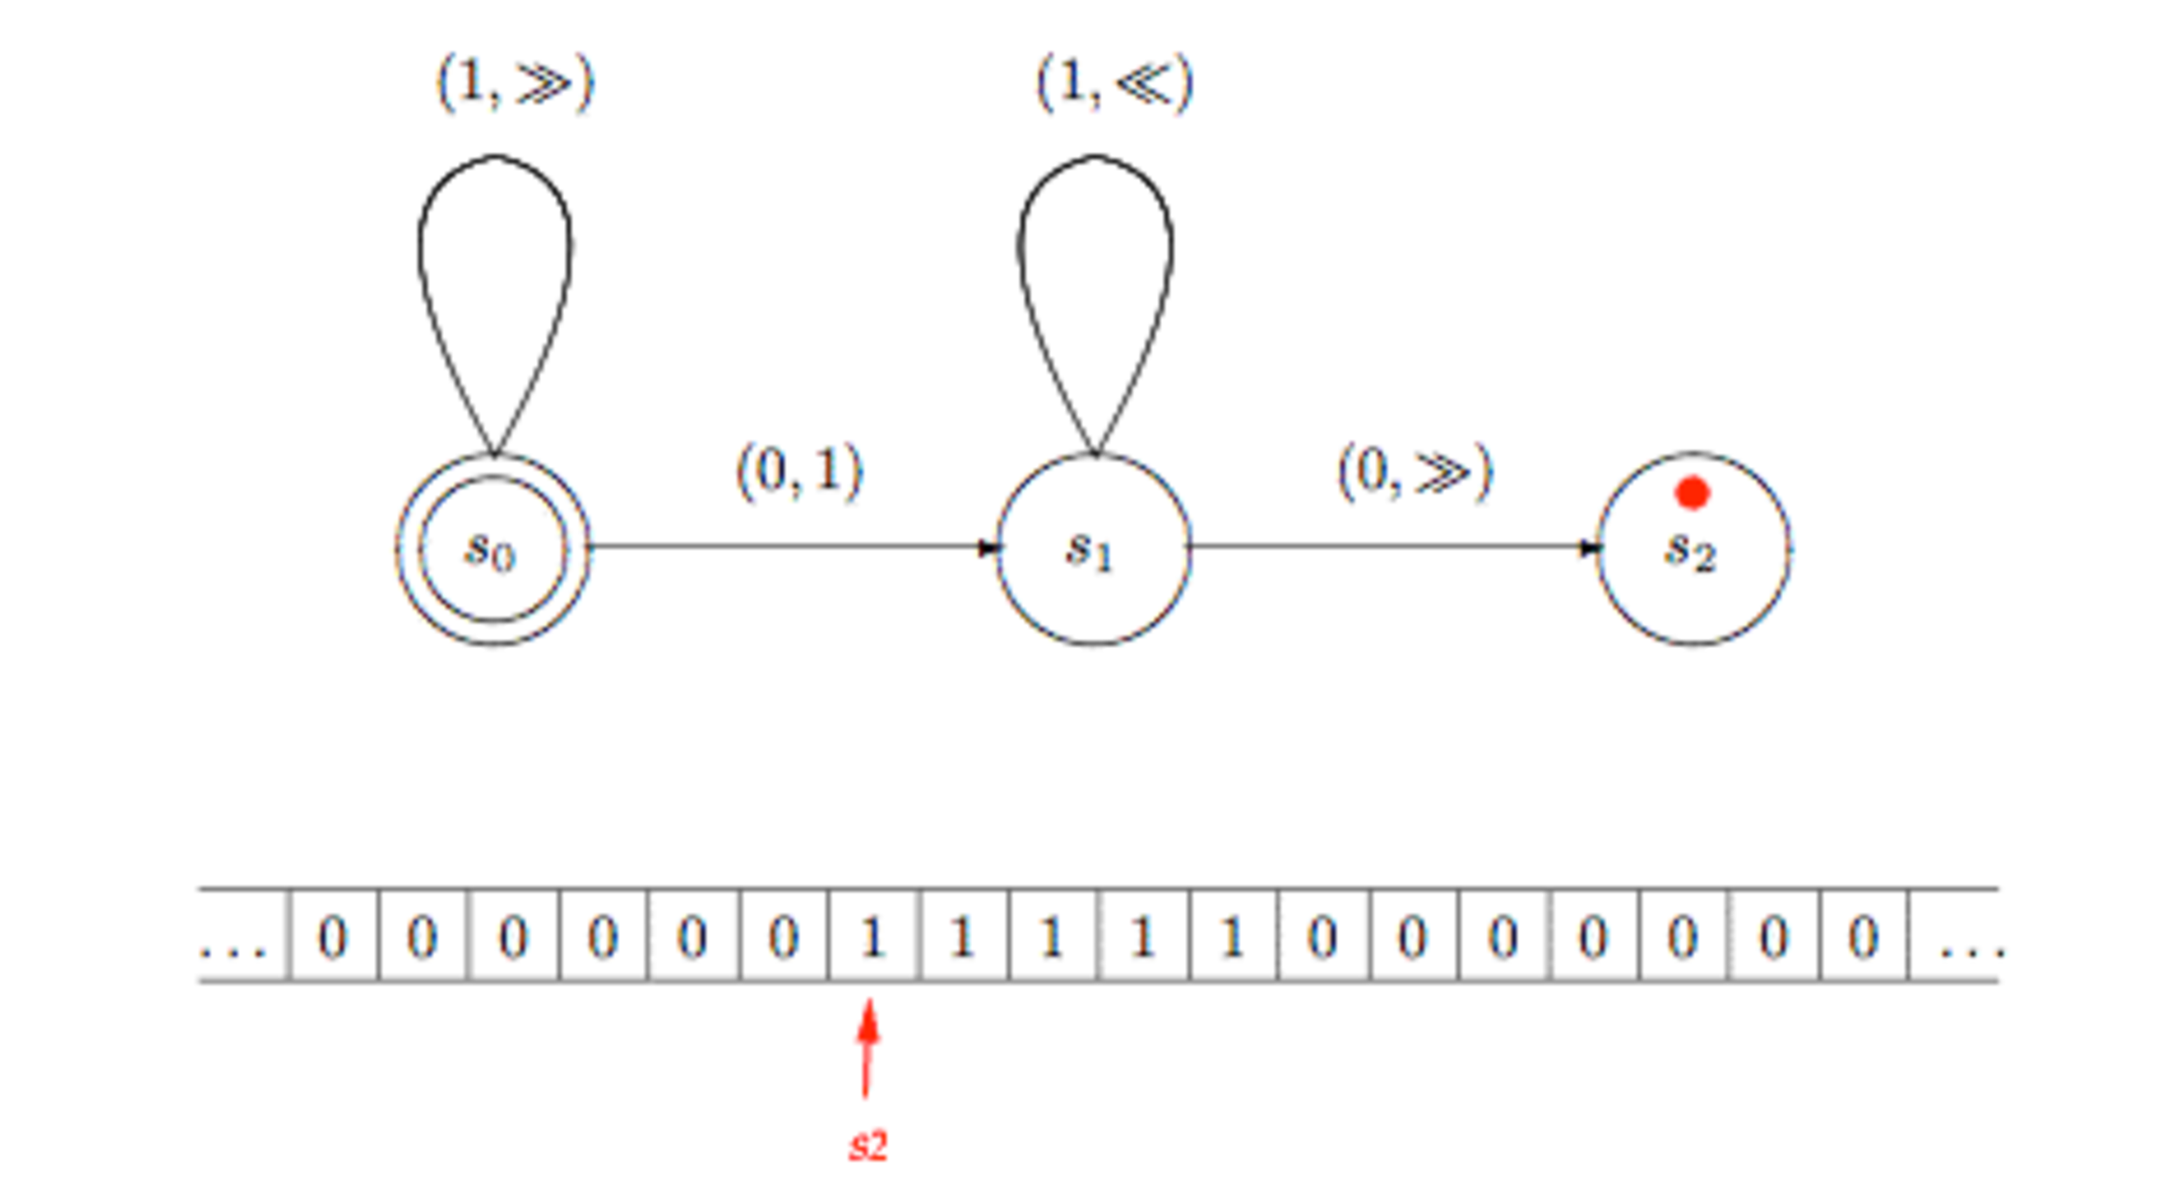
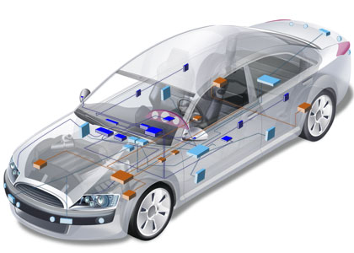

General Purpose
Languages
Assembly ?
COBOL ? LISP ? C ? C++ ?
Java? PHP ? C# ? Ruby ?
Notes:
http://plato.stanford.edu/entries/turing-machine/

Slide 17
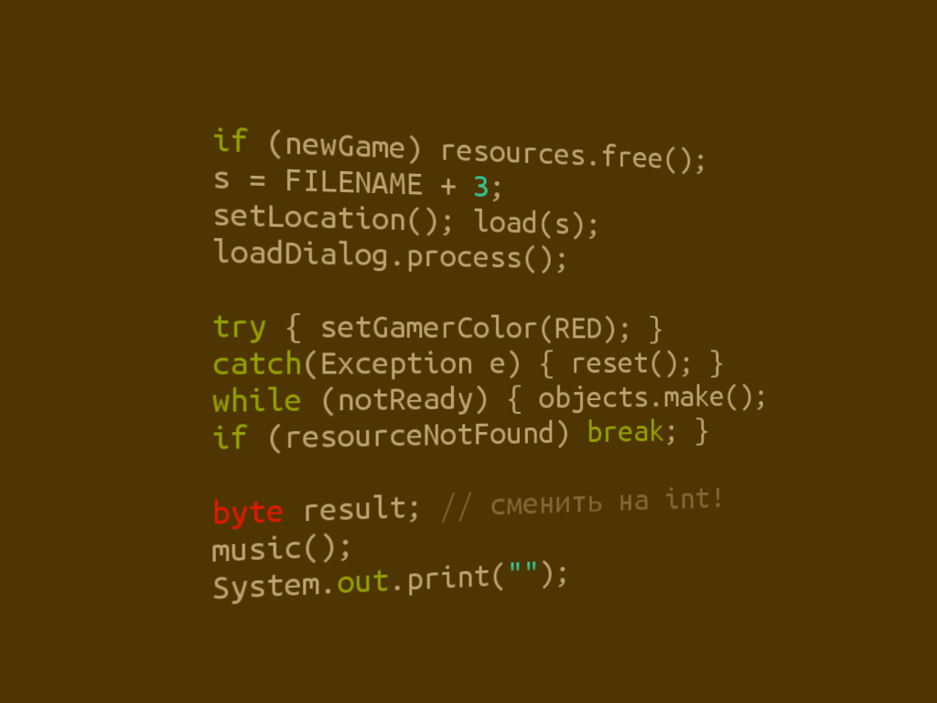
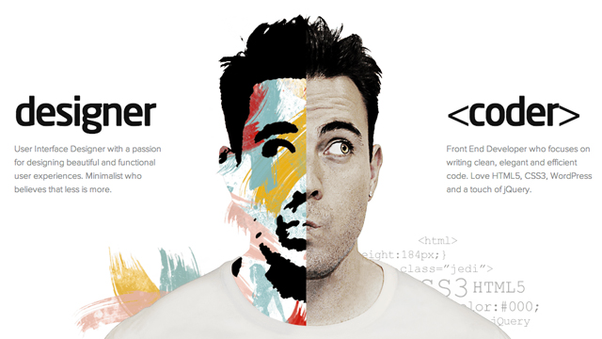
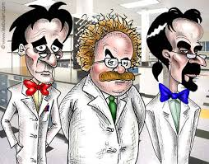

Limits of General Purpose Languages (1)
Abstractions and notations used are not natural/suitable for the stakeholders

Slide 18

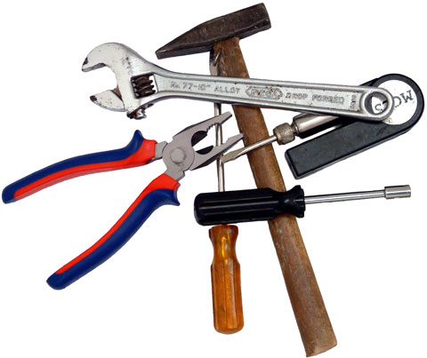
Limits of General Purpose Languages (2)
Not targeted to a particular kind of problem, but to any kinds of software problem.

Slide 19
Domain Specific Languages
Targeted to a particular kind of problem, with dedicated notations (textual or graphical), support (editor, checkers, etc.)
Promises: more « efficient » languages for resolving a set of specific problems in a domain

Slide 20
Domain Specific Languages (DSLs)
Long history: used for almost as long as computing has been done.
You’re using DSLs in a daily basis
You’ve learnt many DSLs in your curriculum
Examples to come!

Slide 21
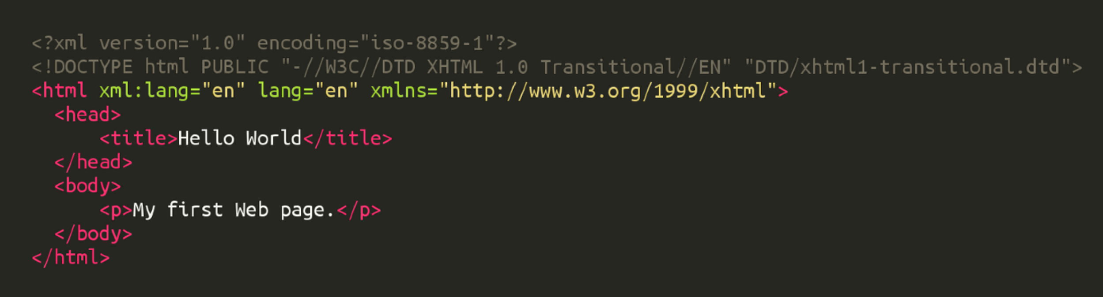
HTML
Domain: web (markup)

Slide 22
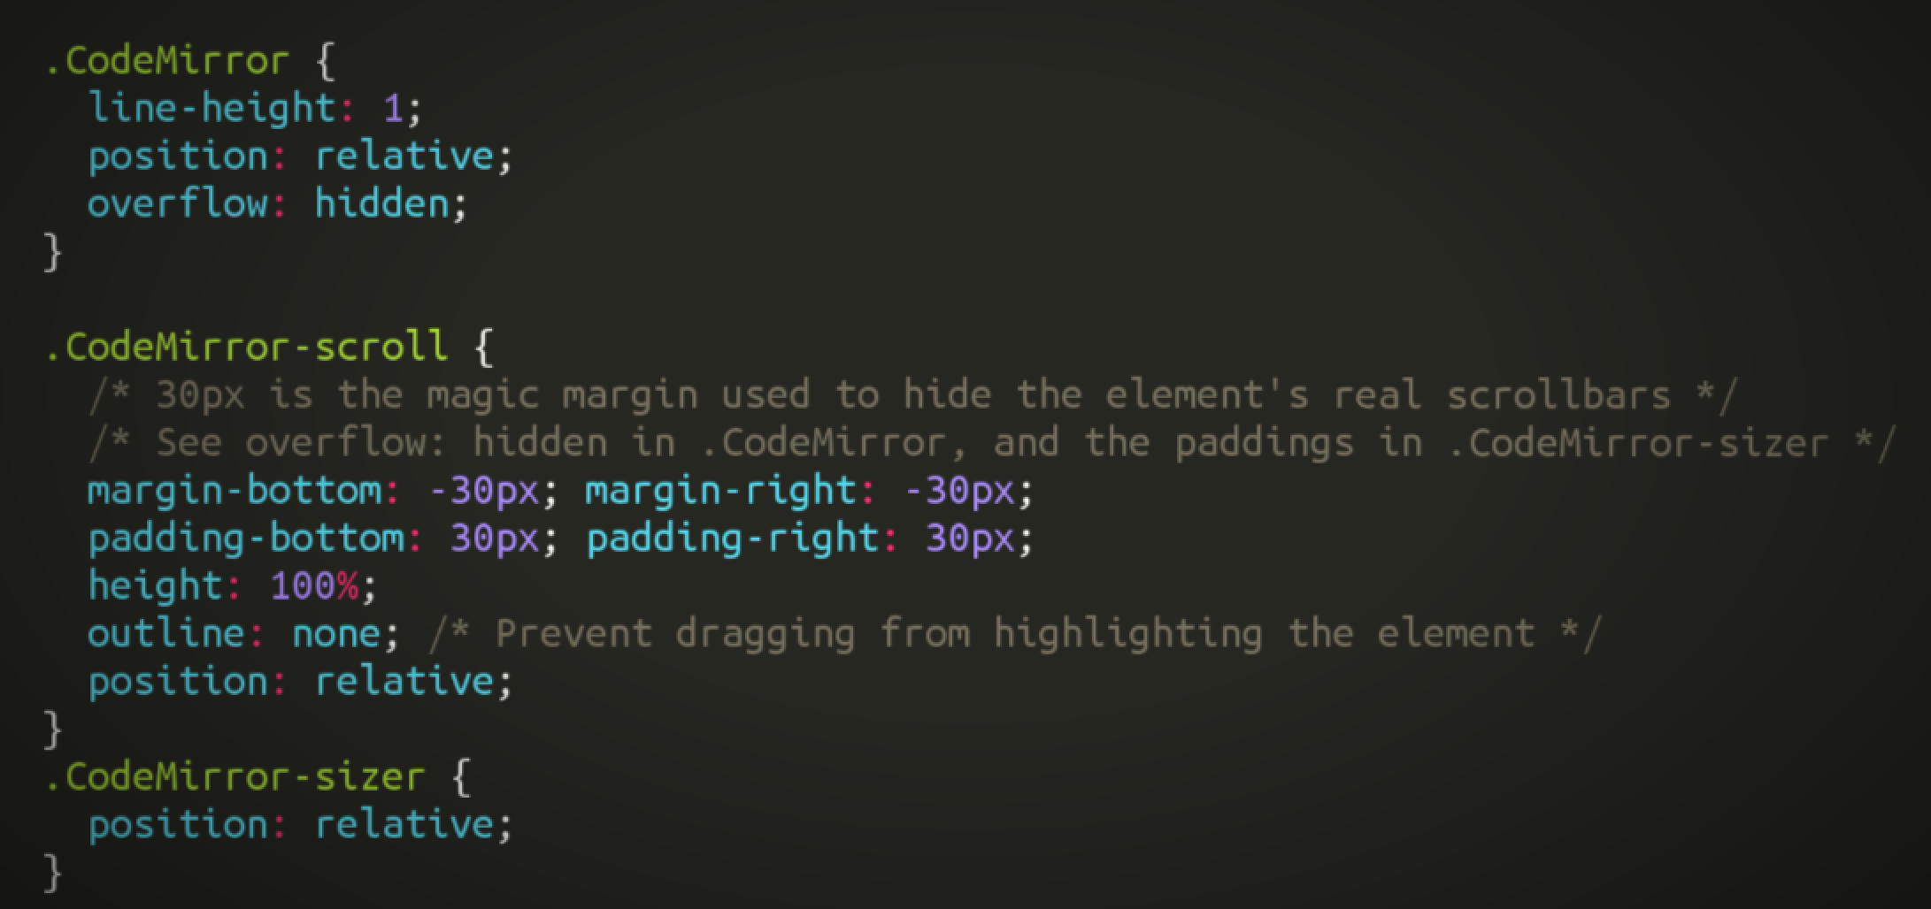
CSS
Domain: web (styling)

Slide 23
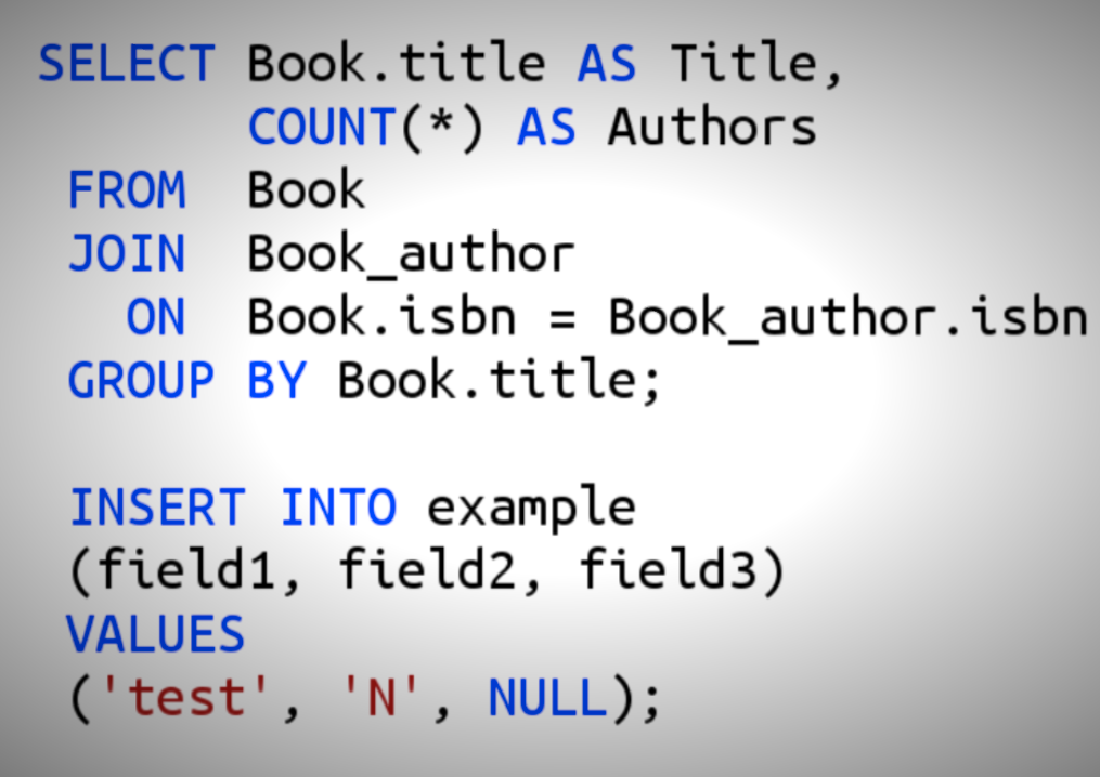
SQL
Domain: database (query)

Slide 24
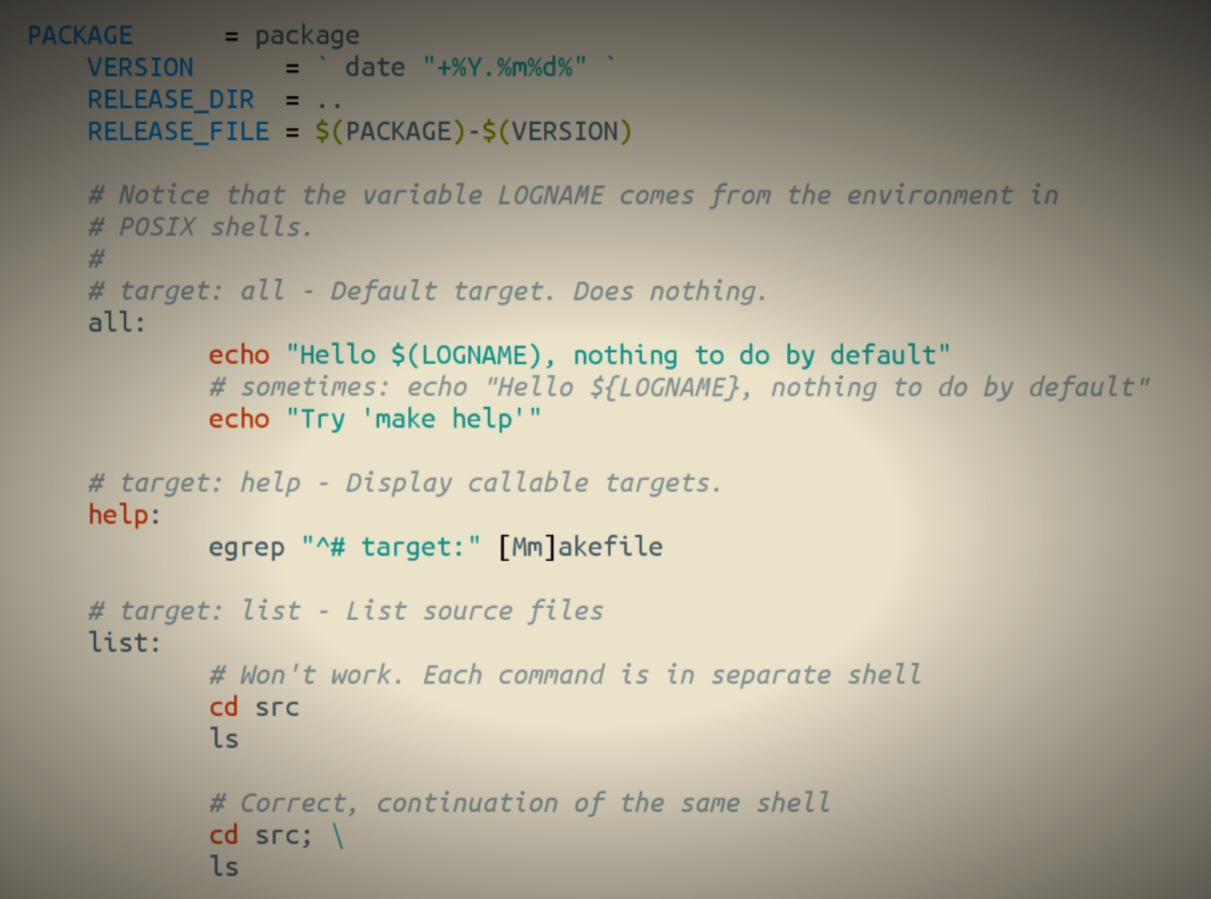
Makefile
Domain: software building

Slide 25
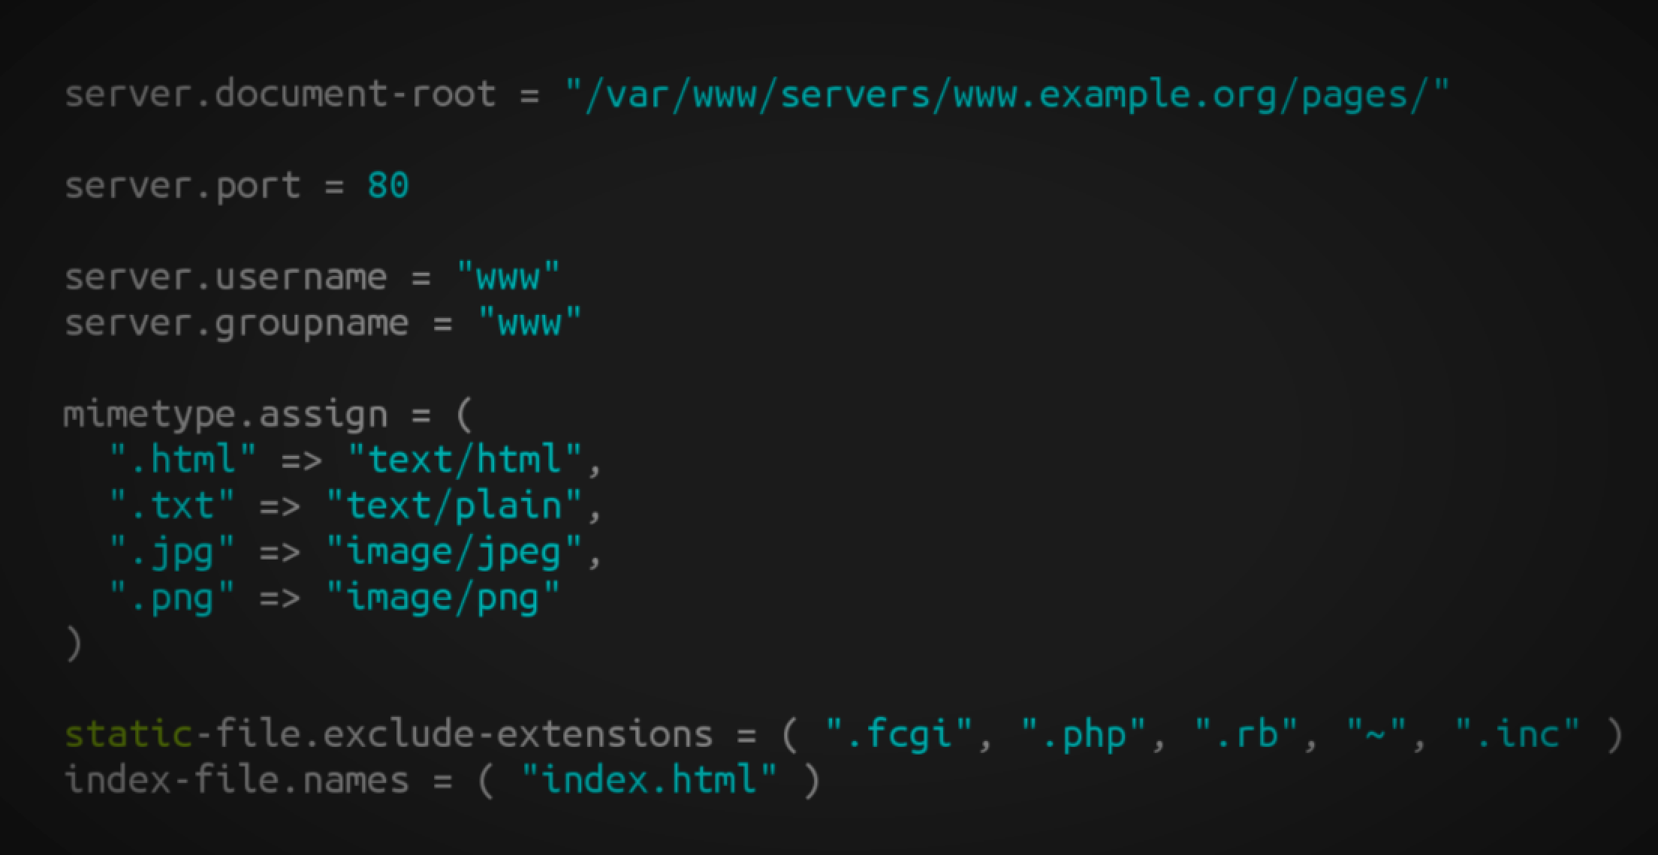
Lighthttpd configuration file
Domain: web server (configuration)

Slide 26
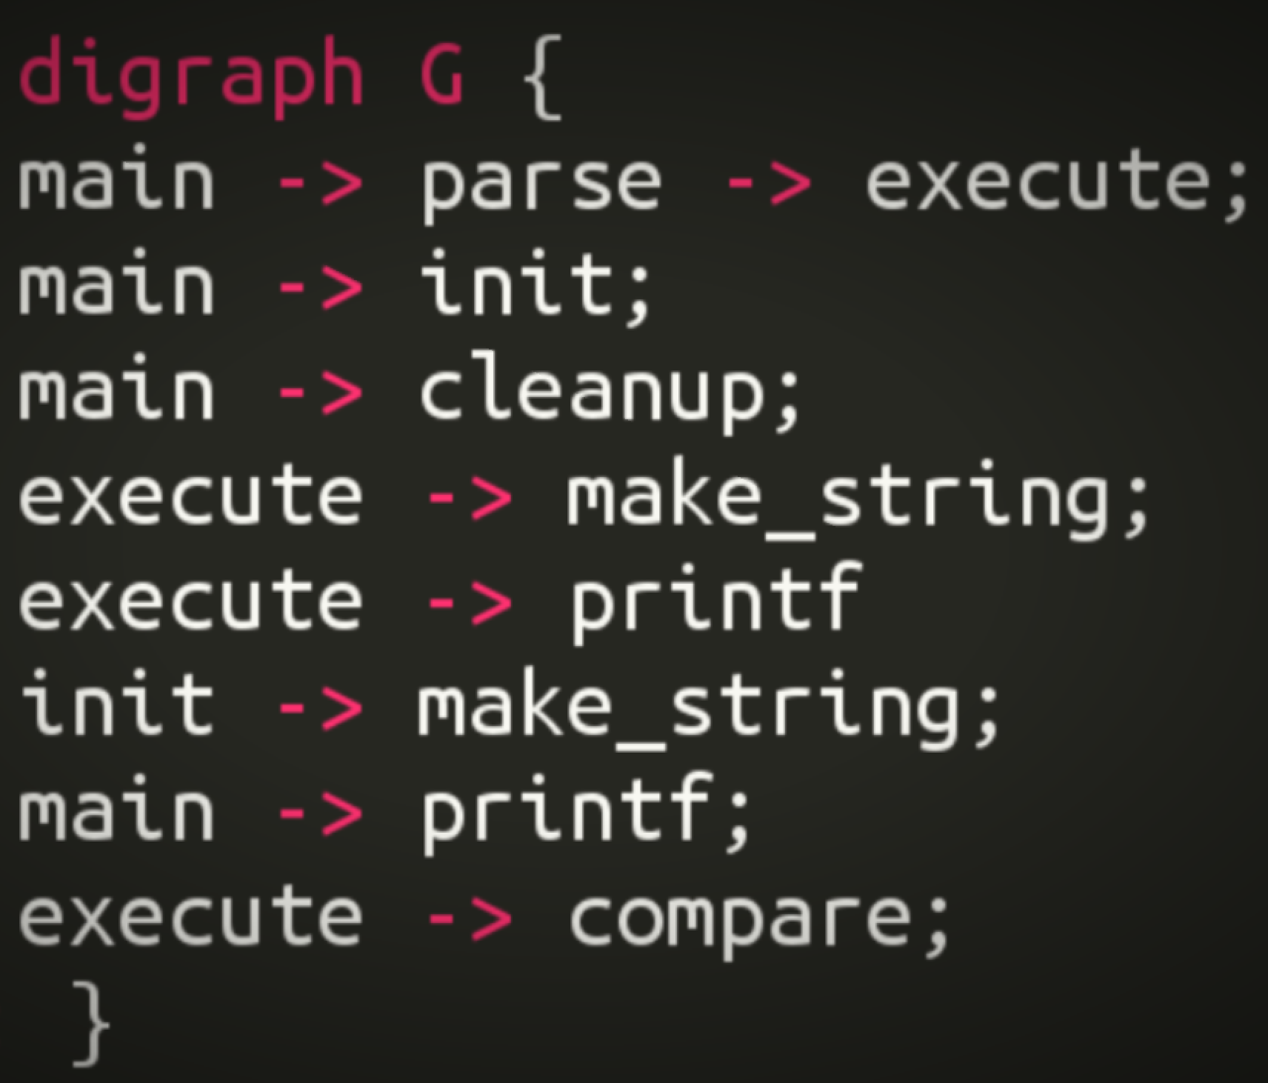
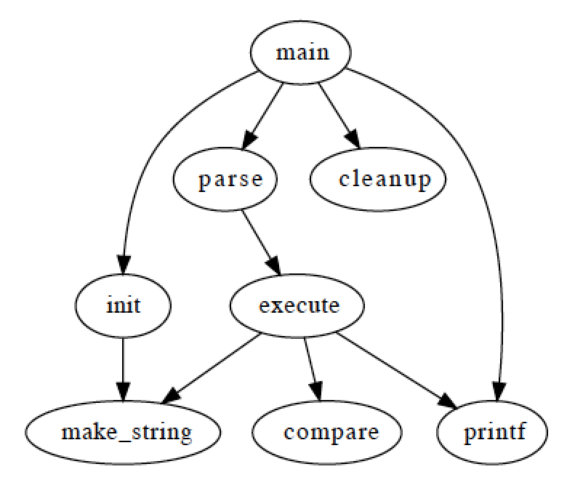
Graphviz
Domain: graph (drawing)

Slide 27
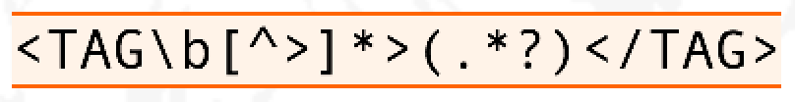
Regular expression
Domain: strings (pattern matching)

Slide 28
OCL (Object constraint language)
self.questions->size
self.employer->size
self.employee->select (v | v.wages>10000 )->size
Student.allInstances
->forAll( p1, p2 |
p1 <> p2 implies p1.name <> p2.name )
Domain: model management

Slide 29
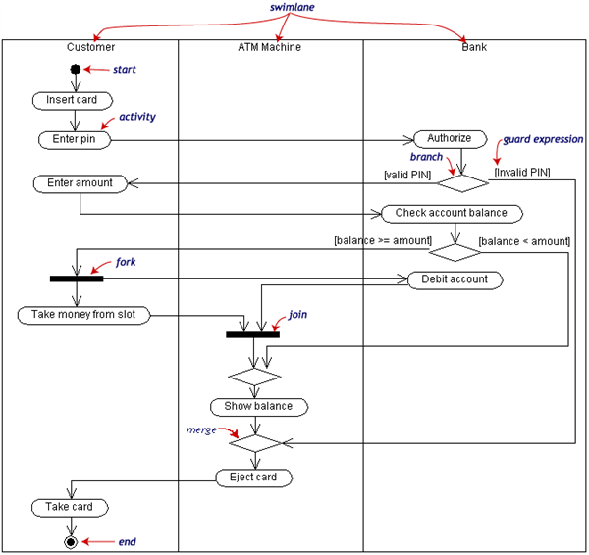
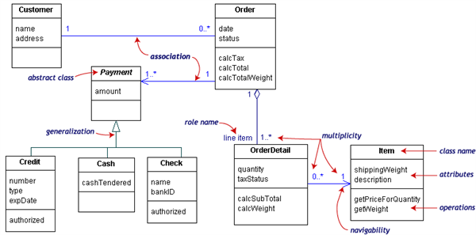
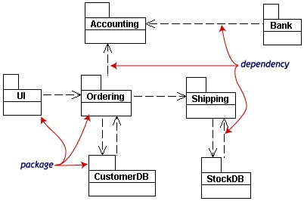
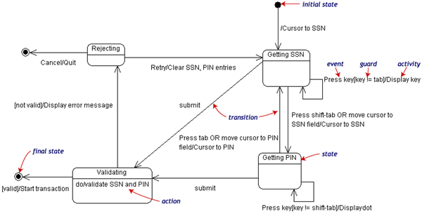
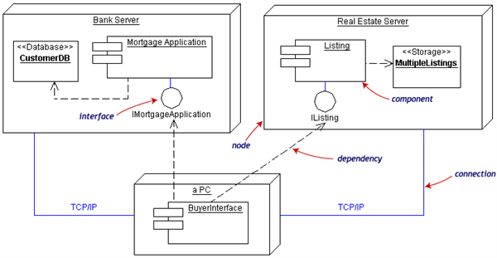
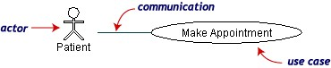
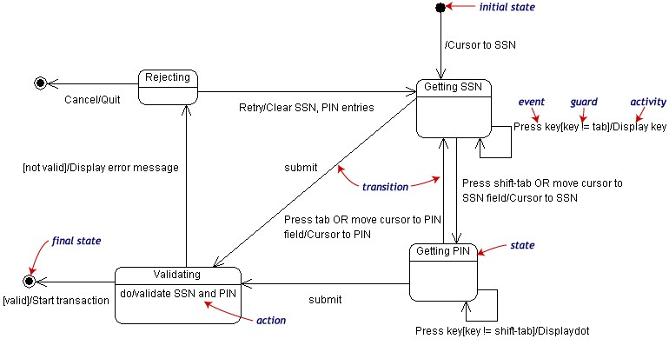
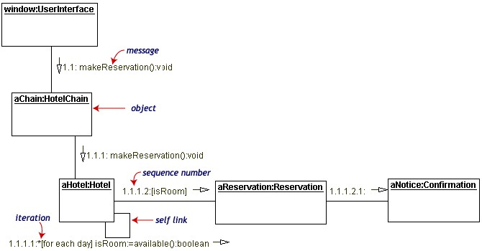
UML can be seen as a collection of domain-specific modeling languages
Structural
Behavioral

Slide 30
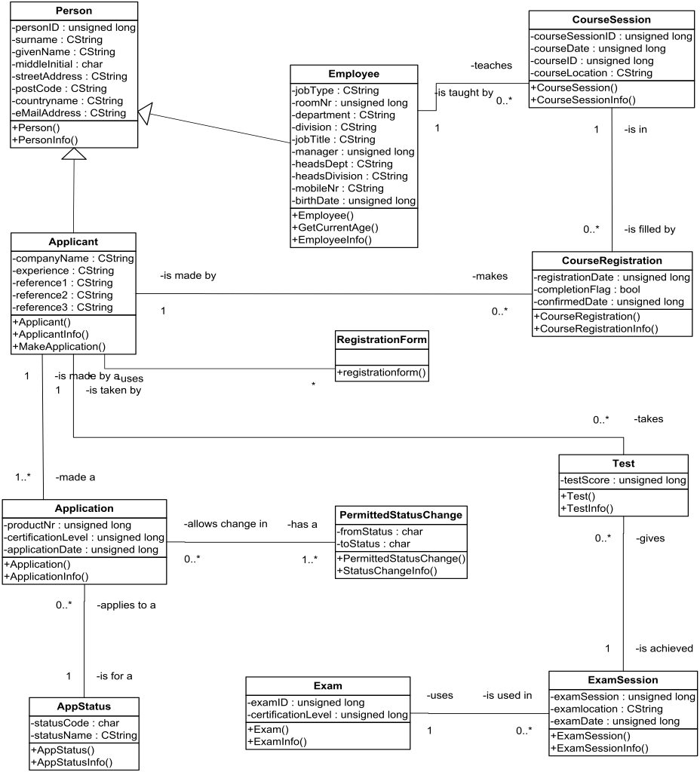
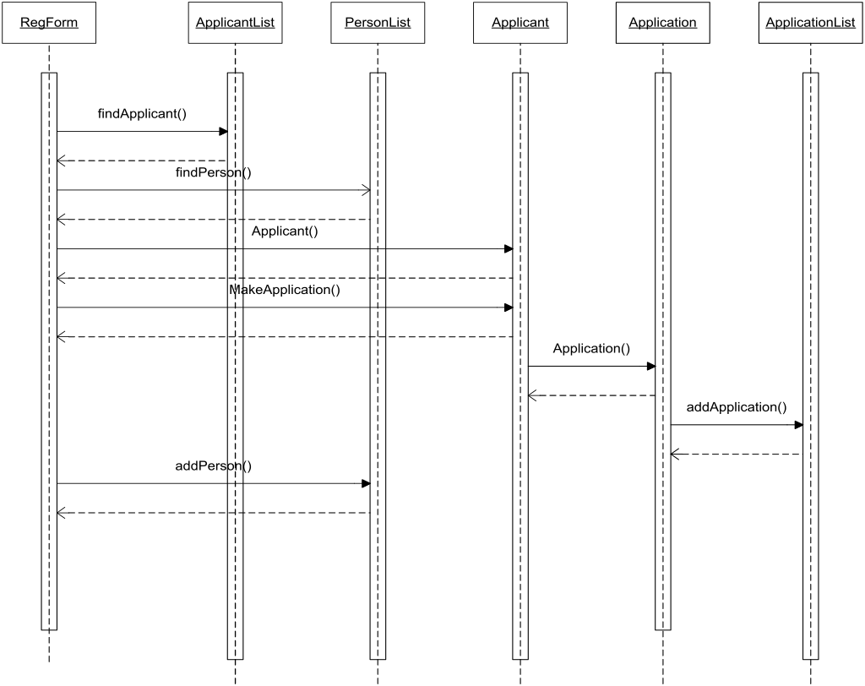

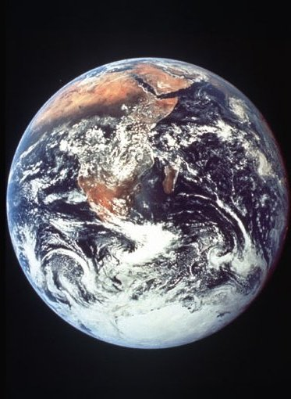

Modeling in Science & Engineering
A Model is a simplified representation of an aspect of the World for a specific purpose
Specificity of Engineering:
Model something not yet
existing (in order to build it)
M₁
(modeling
space)
Is represented by
M₀
(the world)

Slide 31
Defining languages

Slide 32
Software Language Engineering (SLE)
Application of systematic, disciplined, and measurable approaches to the development, deployment, use, and maintenance of software (domain-specific) languages
Supported by various kind of "language workbench"
Eclipse EMF, xText, Sirius, Melange, GEMOC, Papyrus
Jetbrain’s MPS
MS DSL Tools
Etc.
Various shapes and ways to implement software languages
External, internal or embedded DSLs, Profile, etc.
Grammar, metamodel, ontology, etc.
More and more literature, a dedicated Intl. conference (ACM SLE, cf. http://www.sleconf.org)…

Slide 33
Comparing Abstract Syntax Systems
Technology #1
(formal grammars
attribute grammars,
etc.)
Technology #2
(MOF + OCL)
Technology #3
(XML Meta-Language)
Technology #4
(Ontology engineering)
M³
A XML DTD
Or Schema
EBNF
MOF
Upper Level
Ontologies
M²
Pascal Language
Grammar
The UML
meta-Model
A XML
document
A XML DTD
or Schema
KIF
Theories
M¹
+Description
Logics
+Conceptual
Graphs
+etc.
A specific
Pascal Program
A Specific
UML Model
A XML
document
+ Xlink, Xpath, XSLT
+ RDF, OIL, DAML
+ etc.
A specific
execution
of a Pascal
program
A Specific
phenomenon
corresponding to
a UML Model
[XMI=MOF+XML+OCL]
(From J. Bézivin)

Slide 34
Domain-Specific Languages (DSLs)
Targeted to a particular kind of problem, with dedicated notations (textual or graphical), support (editor, checkers, etc.)
Promises: more « efficient » languages for resolving a set of specific problems in a domain

Slide 35

Model-Driven Engineering (MDE)
Engineering Modeling Languages: Turning Domain Knowledge into Tools, by Benoit Combemale, Robert B. France, Jean-Marc Jézéquel, Bernhard Rumpe, Jim R.H. Steel, and Didier Vojtisek. Chapman and Hall/CRC, pp.398, 2016. Companion website: http://mdebook.irisa.fr

Slide 36
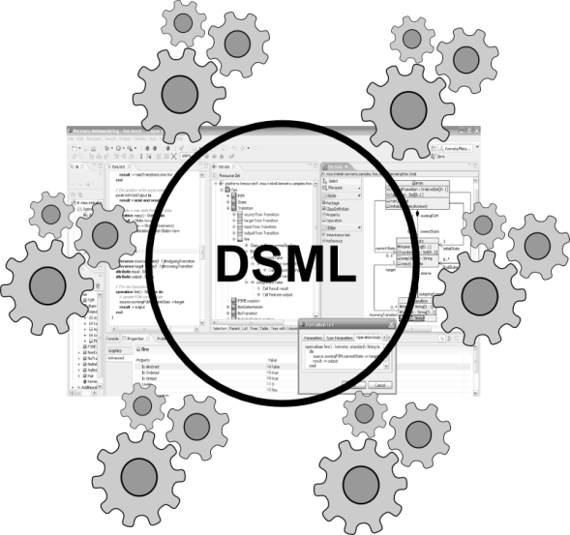
Model-Driven Engineering (MDE)
Editors
(textuals, graphicals, …)
Checkers
(static & dynamics)
Compilers
Test generators
Translators
Simulators
Code generators
Analyzers
Refactoring
Etc.
Engineering Modeling Languages: Turning Domain Knowledge into Tools, by Benoit Combemale, Robert B. France, Jean-Marc Jézéquel, Bernhard Rumpe, Jim R.H. Steel, and Didier Vojtisek. Chapman and Hall/CRC, pp.398, 2016. Companion website: http://mdebook.irisa.fr

Slide 37
From Metamodels to Languages
How do these things relate?
MOF
EMOF
ECore
Infra
Etc.
Generic
Syntax (HUTN)
Abstract
Syntax
Semantic
Specification
Concrete
Syntax
Concrete
Syntax
Concrete
Syntax
Semantics
The language I want to build

Slide 38
Eclipse plugin structure and lifecycle
integrated development environment with base workspace and an extensible plug-in system world)
Contribute to existing IDE
Open structure with thirdparty contributions
Update site, market place, …
Or create your own application
Rich Client Platform (RCP) for developing general purpose applications
-> component based / service base approach
Equinox : an implementation of OSGI core framework

Slide 39
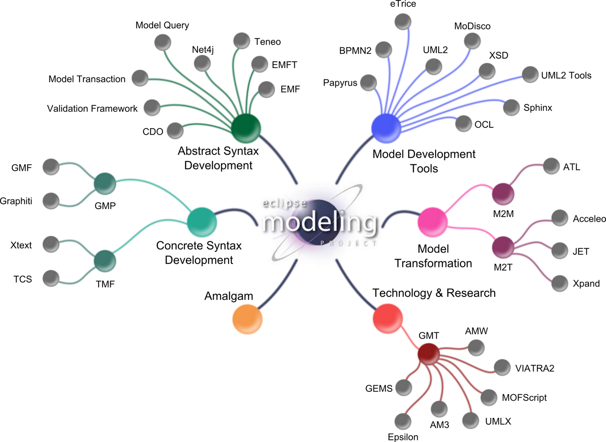
Eclipse Modeling Project
+EcoreTools
+GEMOC

Slide 40
Defining the abstract syntax
Goal: define the concepts of the language
Make them available to tools in order to manipulate them
Provide default services:
API
Serialization

Slide 41
Ecore/EMF
Basically a Class diagram to represent the metamodels
EMF provides for free (among other features)
serialization (XMI)
Tree editor
either reflective, or generated with possibility to customize
Edition support (outline, notification API for other editors, …)
Java manipulation API
EMF compatible projects use this as a base to propose extended services

Slide 42
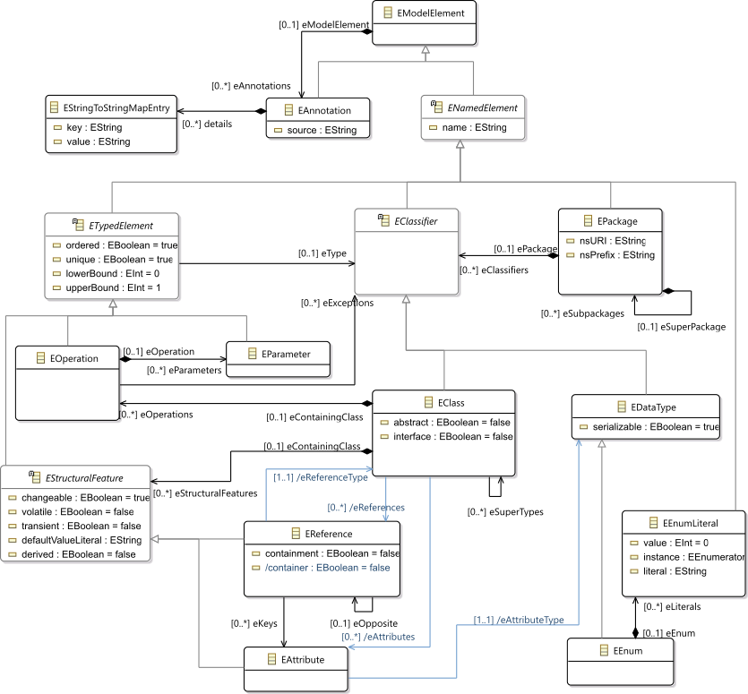
Ecore most used concepts

Slide 43
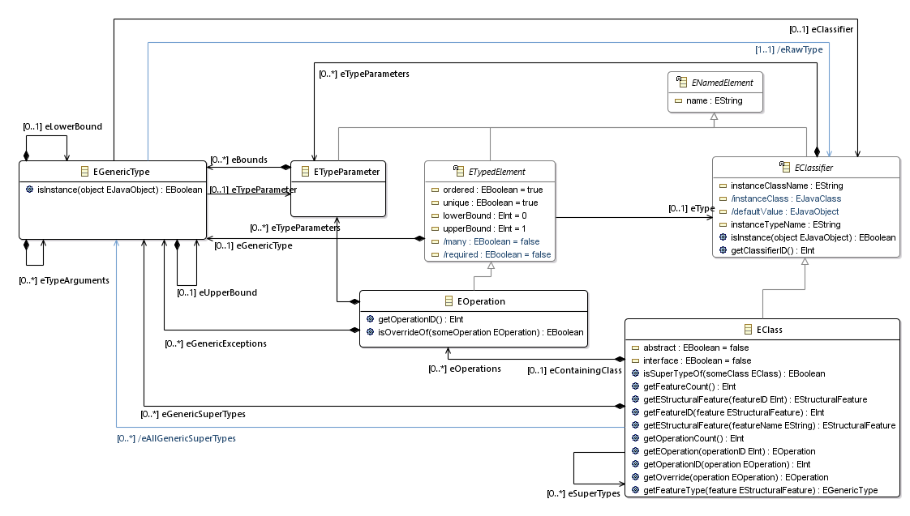
Ecore extended usage
Support of generics
TODO Add usage picture in the tree editor

Slide 44
Design your domain
You can obtain an ecore file by several means:
Using the Ecore tree editor (EMF)
Using the graphical editor (Ecore tools (sirius based))
Using a textual editor (oclinecore, …)
Generating it from another format:
ex: with Xtext, when working grammar first.
However, you may not be able to tune the class diagram (for example, xtext does not help to correctly factorize attributes in a nice inheritance tree)

Slide 45
Containment
A metamodel is not only a graph
Containment information is used by many tools to provide "smart" default implementations
Tree editor, textual syntaxes, graphical syntaxes, …
Impact on model transformation

Slide 46
Assigment semantics: maintain consistency
A
b
B
C
c
d
D
0..1
1
*
container()
c
a1:A
b
a1.b is changed too
d
b1:B
c1:C
d1:D
a2:A
c2:C
a2.b := b1
d1.c := c2
a1:A
b
b1:B
c1:C
d
d1:D
a1.b changed too
c1.d changed too
c2:C
a2:A
container()
c

Slide 47
Defining a concrete syntax
Each abstract syntax may have more than one concrete syntax.
They represent views on top of it
with more or less overlapping:
ex: textual for some concepts, forms for other concepts and graphical for some more concepts.

Slide 48
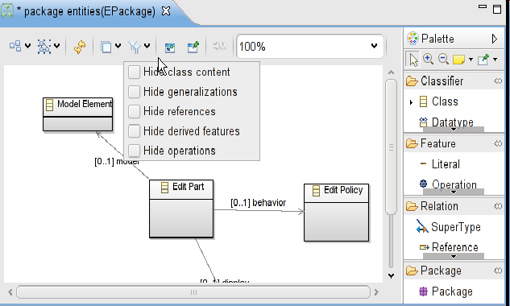
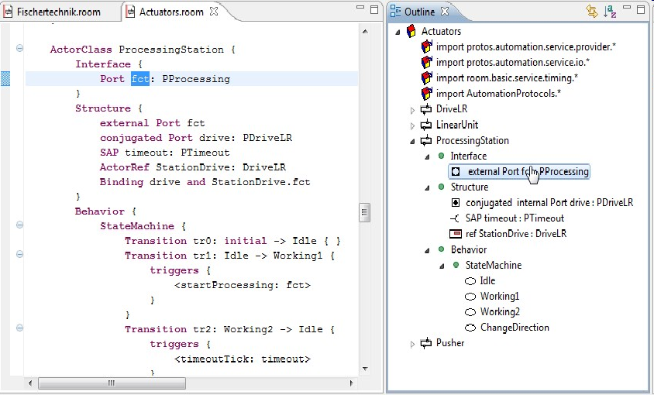
Bridging grammar/model space

Slide 49
Defining a concrete syntax: tree based
for free using EMF (ie. default configuration model is enough and often restricted to bare minimum)
optionnaly need some customization
in the genmodel
icons, labels,
tables,
properties view
Often reused as outline for more complex editors

Slide 50
Defining a concrete syntax: textual

Slide 51
M³
EBNF
Metametamodel
Grammar
Metamodel
M²
M¹
Source
Code
Model

Slide 52

Give me a grammar,
I’ll give you (for free)
* a comprehensive editor (auto-completion, syntax highlitening, etc.) in Eclipse
* an Ecore metamodel and facilities to load/serialize/visit conformant models (Java ecosystem)
* extension to override/extend « default » facilities (e.g., checker)

Slide 53

Xtext, Grammar, Metamodel
Xtext, Grammar, Metamodel
Grammar
Metamodel
conforms To
conforms To
Source Code
A
Model A

Slide 54
Defining a concrete syntax: graphical
Sirius
Interpreted
provides mapping between Node/Edge with domain concepts

Slide 55
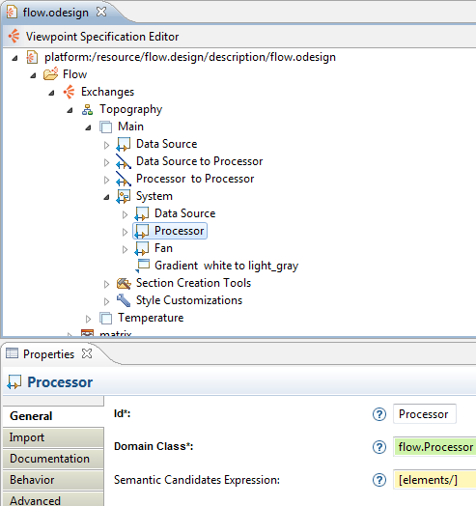



Sirius principlesprinciplesprinciple
Modeling environment
Specification environment

Slide 56






Resources
Tool Specifiers/Developers
End Users
Modeling Tool
Representations
created with
<myDomain>.odesign
representations.aird
references
represent
<myDomain>.ecore
myModel.<myDomain>
conforms to
Domain
Data

Slide 57








Exemple
Specification
Usage

Slide 58
Defining a concrete syntax: other
other representations are possible
forms (ex: web, properties view), tables (excel , more or less dedicated to a domain), domain specific (3D models, maps,statistical graph and charts, timing diagrams, gauges and meters, dashboard with sliders and wheel buttons...)
however, due to their close relationship with the target domain, it might be (currently) more difficult to find a generator for them and will require some classic programmation

Slide 59
Static semantics
Not all constraints can be handled structurally by the metamodel.
one extreme MM is Node+Edge which can be specialized for any language simply by adding invariant contraints
-> Use of Validators
to get errors, quickfixes, etc
OCL (Object constraint language) ?
yes its syntax is elegant but tooling integration (in Eclipse) is not at the state of the art
Use of Xtext validation (if the language has a textual concrete syntax) or directly Eclipse validation framework (ie. in java)

Slide 60
Model transformation: from contemplative to productive models
Operate on graph
Text to Model and Model to text
partly covered and simplified by xtext
can also be treated using traditionnal approaches
lexer/parser
template, toString,
Model to model

Slide 61
Characterization of model-to-model techniques
Homogeneous vs heterogeneous
ie. in-place transformation
may be useful to clearly know what model is an input or an output
Declarative vs imperative
Declarative: focus on the "what", by establishing correspondences, the engine will then organize control flow
Imperative: provide full control of the transformation process

Slide 62
Dynamic semantics
Interpreter vs compiler
Operationnal vs translationnal
Interpreter
pro: easy to write, good relationship with original model, suitable for simulation
cons: slow
Compiler
pro: fast, suitable for deployment in real system
cons: need additional traceability mechanism for debug, need good understanding of target domain, may be complex to write and require several passes

Slide 63
Model transformation general form
Definition of
transformation T: A->B
Metamodel A
Metamodel B
instanceOf
instanceOf
instanceOf
An application of
transformation T(a) = b
Model a
Model b

Slide 64
Model transformation from the programmer point of view
Transformation
Metamodel
Ecore
Ecore + actions (ALE)
transformation DSL
Ecore
Source Metamodel
Transformation model
Target Metamodel
B
C
C
D
D
E
E
B
B
C
A
F
F
H
H
Source model
Target model
:A
:C
:F
:E
:H
:C
Transformation
execution
:C

Slide 65
Organising transformation: bigger picture
Might be complex because it can help to formalize all stages
Ex: PIM-PSM (old figure but shows various stages and modeling point of views)
Modeling
point of views
Endomorphic Transformations
Exomorphic Transformations
Outside UML scope
Proofs,
QoS
Analysis,
Simulation
Technical
Aspects
Business
Aspects
Text
(e.g. XML)
Formal Models
Formal Models
PIM=Platform "Independent" Model
PSM= Platform "Specific" Model
PIM
PSM
Code
Tests
PIM
PIM
PIM
PSM
Doc
Doc
Doc
Doc
Doc
Doc
Lifecycle
Requirements
Analysis
Architectural
Design
Detailed
Design
Implementation
Validation

Slide 66
Let's focus first on some concrete activities
Dynamic semantics
ie. express the behavior of the model

Slide 67
Dynamic semantics
Note: Both interpreters and compilers can be written using imperative or declarative techniques
Note: Interpreter and compiler can be seen as special case of model transformation / model manipulation
they take an (executable) model as input and produce some output (modification on the runtime data in case of interperter, and text generation

Slide 68
Interpreter
This is a model transformation that reads the executable model and produces some effect on runtime data.
--> need to add runtime data
--> need to add computational steps
Several techniques are possible:
Interpreter design pattern
Visitor + interpreter design pattern
Aspect weaving

Slide 69


Example on FSM
A model
Its metamodel
Adding Operational Semantics to OO Metamodels

Slide 70

Example on LogoLogo
TODO, old version of the picturepicture ! replace with current ecorecore
(Statement -> Instruction ...)...)...Instruction
Logo.ecore

Slide 71

Example on Logo
VMLogo.ecore
Runtime data
+ some helper functions
on these RTD
@Aspect(className=typeof(Turtle))
class TurtleAspect {
def void move(double dx, double dy) {
var Point newPos = _self.position.getDelta(dx,dy)
if (_self.penUp) {
println("Turtle move to "+ newPos.asString)
} else {
println("Turtle trace to "+ newPos.asString)
_self.drawings.add(vmLogo.VmLogoFactory.eINSTANCE.createSegment.initialize(_self.position,newPos))
}
_self.position = newPos
}
def void forward(int steps) {
var double radian = Math.toRadians(_self.heading)
_self.move(_self.scale(steps,Math.sin(radian)),_self.scale(steps,Math.cos(radian)))
}

Slide 72
Example on Logo
@Aspect(className=typeof(Forward))
public class ForwardAspect extends PrimitiveAspect{
@OverrideAspectMethod
def int eval (Context context) {
var int param = _self.steps.eval(context)
println("FORWARD " + param)
context.turtle.forward(param)
return 0
}
}
@Aspect(className=typeof(If))
public class IfAspect extends ControlStructureAspect{
@OverrideAspectMethod
def int eval (Context context) {
if (_self.condition.eval(context) != 0) {
return _self.thenPart.eval(context)
}
else{
return _self.elsePart.eval(context)
}
}
}
LogoDynSemantics.xtend

Slide 73


Changing point of view / Model transformation
Bridge between DSL are written as model transformation
Switching to from one model (DSL) to another may have many benefits
human understandability / analysis / maintainabilty / efficiency
This is similar to Math and physics "models"
Cartesian coordinate system / Polar coordinate system: some transformations are simplier to express or more efficient (translation vs rotation)
Fourier transformation in signal processing
etc

Slide 74
Models/DSLs and open world
In real life, we don't know yet the future usages and concerns.
However we'll have to combine them.
Syntacticaly
Semantically
Techonologically (May be expressed using different technological stacks (java/c++/python/uml/mathlab/...))
Note: I do not have the best "solution" but try to show what need to be tackled and which combinaison has tools.

Slide 75
Combining models/DSL
C
B
A
D
for each, many strategies :
general purpose
has often the syndrom: "I'm the center of the world the other doesn't exist or should come to me" (but I truly consider only my use cases)
point to point,
pivot
more realistic: hybrid multipivot ?
Select best for each use and build helper tool to ease transitions
E
H
F
G
B
C
A
D
E
H
F
G
B
C
D
E
A
H
F
G

Slide 76
Bridge between ridge between technological spaces
Ideally this includes:)
math, physics, and many other computer science domains such as (onthologies, AI, general programming + libraries, ......!)
MDE/SLE: focus is on Enginering => tooling
Ontologies: focus is on understanding/classifying

Slide 77
GEMOC
Provide tooling/framework for the nticssemanticssemantooling
simplify debuggersimulation/sim development (ie. have something similar to java modern ide debugger for any executable language
Challenges: (among others)
model coordination (several models expressed in different or in the same language)
support of many paradigms for expressing the behavior
Imperative/Declarative
Semantic choices (ie. a language may allow several execution pathes for a given model)
Discrete/Continuous

